Slide 1
Final Presentation
Bijoy Singh (120050087)
Sai Kiran Mudulkar(120050068)
Manik Dhar(120050006)

Slide 2
Whats in this presentation?
This presentation does not contain the details of each lab, it only contains the conclusions and results
It also contains what special and unique things our group did in this lab.
We have detailed presentations for each lab too.

Slide 3
A* Star Search
Made an abstract implementation in python using object oriented programming.
Implementation of A* Algorithm and storage data structure is independent of the problem at hand, making it abstract for the user.

Slide 4
8-Puzzle Problem
We implemented the 8-puzzle problem over the above API.
Here are the figures:
No Heuristic : 7695*
Displaced tiles : 353*
Manhattan distance : 42*
*The figures are subject to the definition of less than operator for f-score. The less than condition we have used take h-score as the next candidate if f-score is same.

Slide 5
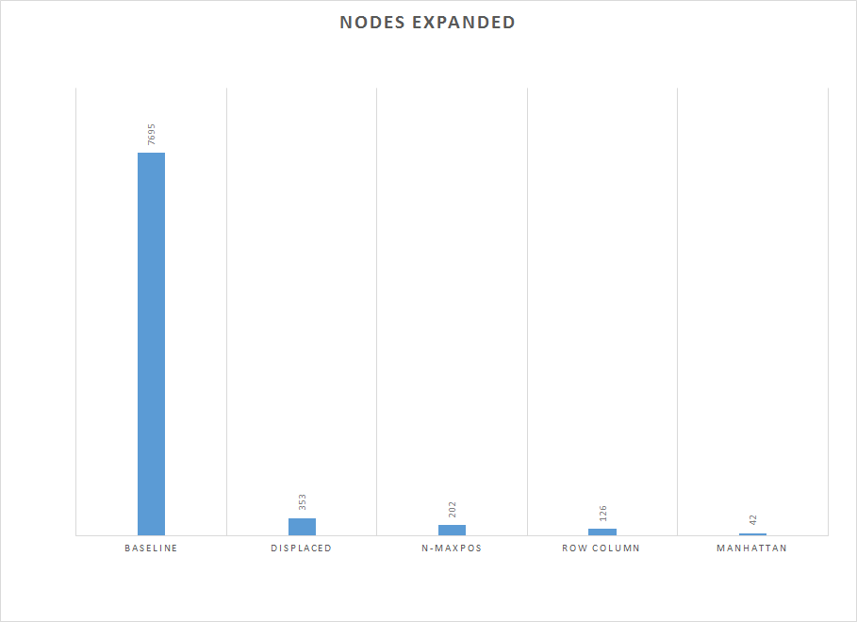
Better Heuristics Perform Better

Slide 6
Our Own Heuristics
We implemented 2 heuristics for the lab
n-Max Swap : The number of moves to reach final states where in each move you can swap the blank tile with any tile
Performance : 202 moves
RC Distance : The sum of the number of tiles not in correct column and number of tiles not in correct rows
Performance : 126 moves

Slide 7
Non Admissible Heuristic
We used a simple way of creating a non-admissible is to scale the Displaced Tiles Heuristic by a factor and added 32*
The effect of increasing the heuristic is evident in the following graph
*32 is the maximum number of moves needed to solve the problem.

Slide 8
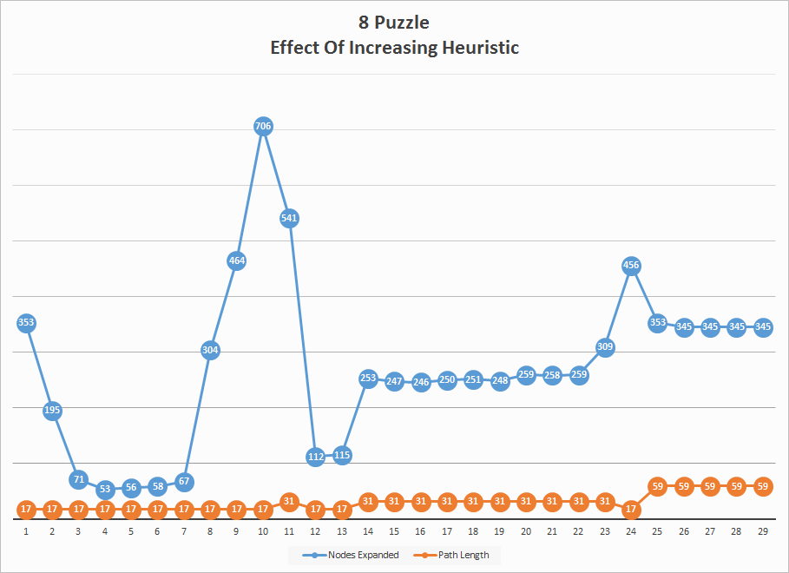

Slide 9
Cannibal Missionary Problem
We solved the cannibal missionary problem using the same API we coded.
Results:
No Heuristic : 25 moves

Slide 10
Our Own Heuristics
1 Basic One Step heuristic : The minimum times a boat must go back and forth for C people in the first side is (C - 1)
Performance 22 moves
2 Two Step heuristic : A more accurate heuristic, which takes care of which side the boat is and how many people are on first side
Performance 19 moves

Slide 11
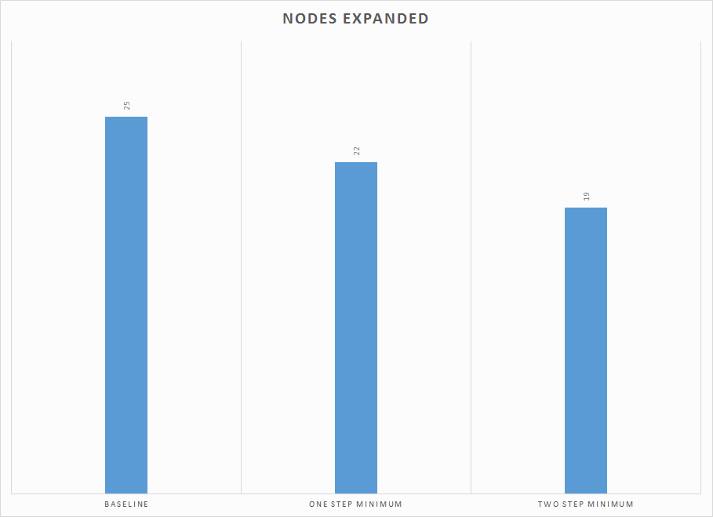
Better Heuristic Perform Better

Slide 12
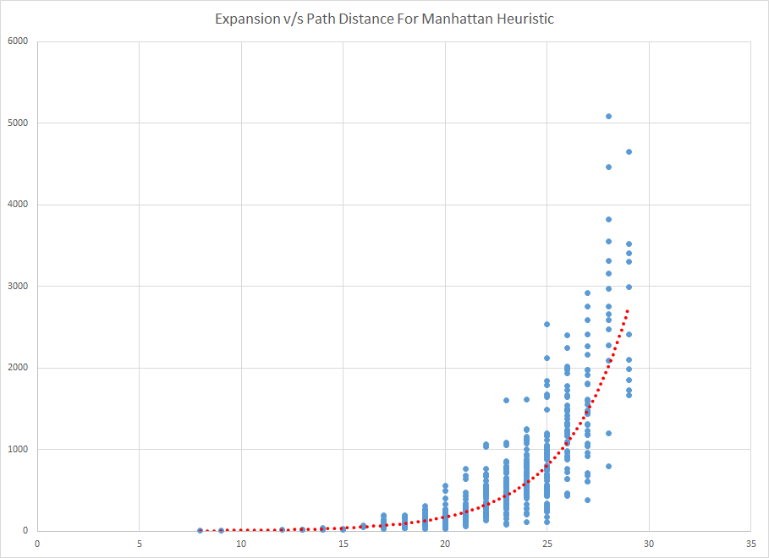

Slide 13
Bidirectional AStar
Implementation:
We use 2 Open Lists and Closed Lists based on the data structures and procedure defined in previous lab.
One open list corresponds to the forward step and the other corresponds to the backward step(from goal to the start)

Slide 14
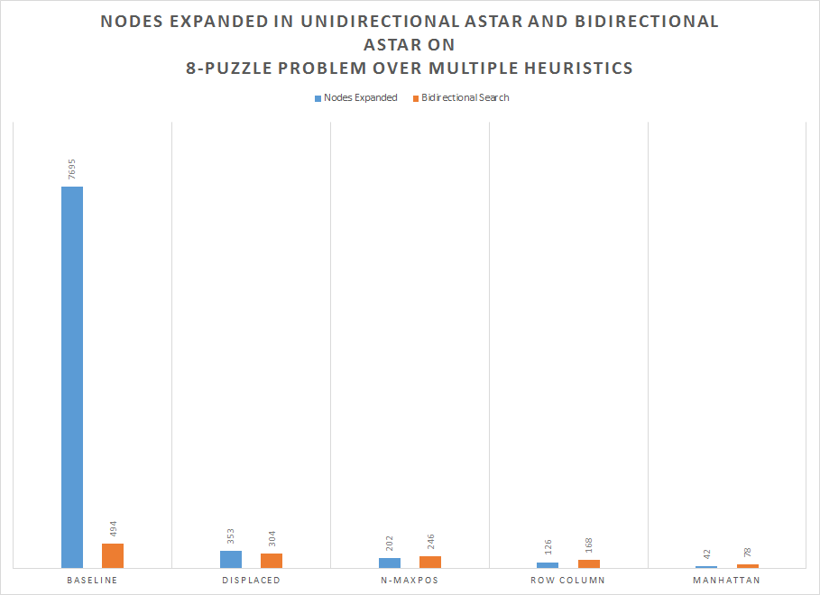

Slide 15
Non Monotonic Heuristic
We used the following method to generate a non monotonic heuristic. Let say we have a monotonic heuristic h available to us. We define a new heuristic hʼ as follows:
hʼ = h if the blank tile is not in the first column
= 0 otherwise
hʼ is a non monotonic heuristic for the 8 puzzle.

Slide 16
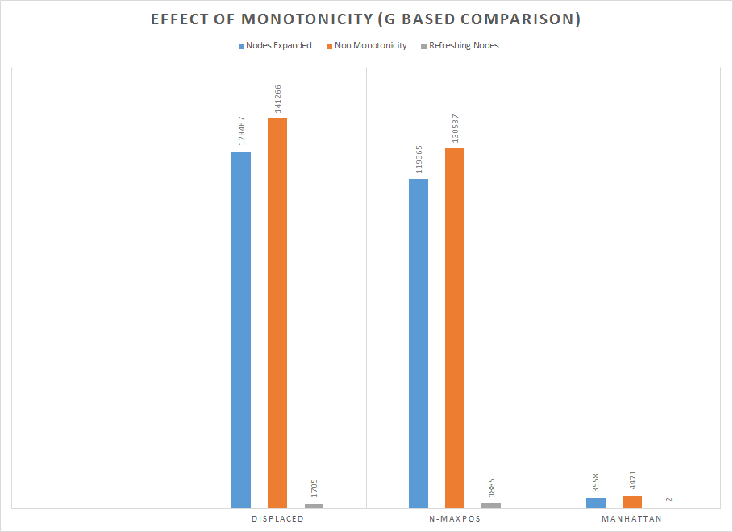

Slide 17
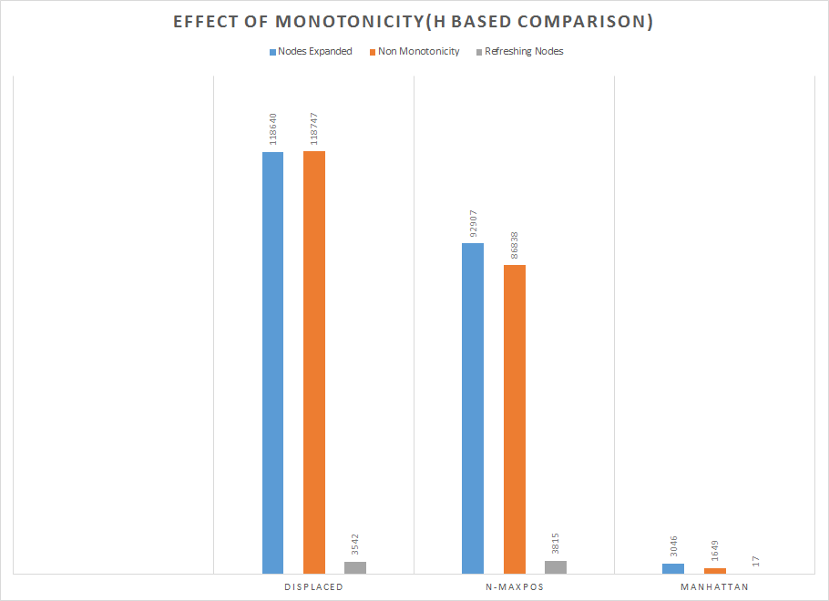

Slide 18
Theorem Prover
We have been given a statement in propositional logic.
The program needs to check whether the statement is a theorem or not.
The use of semantics is not allowed.
Only syntax rules and the deduction theorem is used.

Slide 19
The Method
We create the the maximal set of hypothesis
H1, H2,....,Hs
by deduction theorem, contrapositive and modes pones being applied recursively till the information cannot be gathered

Slide 20
The Method (Contd.)
Let us say we are trying to prove K. If K is of the form ((A -> F) -> F) we remove the double not.
We assume each statement to be of the form (LHS -> RHS) if an implication is present.
We search for K in the RHS of all the statements and if we find it, then we attempt to prove the LHS.

Slide 21
The Method (Contd.)
Also if K is the form of (A -> B) we can prove either (~B -> ~A) or B to finish the job.
This because of contrapositives being equivalent to the original statement and Axiom 1 [(B -> (A -> B)) and B give (A -> B)]
We use Axiom 2 in a similar manner. If K is of the form ((A -> B) -> (A -> C)) we try proving (A -> (B -> C)).

Slide 22
The Method (Contd.)
We keep going backwards in this manner until we get stuck at a hypothesis.
Lets say we got stuck at P1, …, Pg
Now we can assume either to finish the proof or trying proving one of them. We ask for the user’s input here to choose one of them.
Now we attempt to prove it.

Slide 23
User Input
If the process gets stuck(no new hypotheses are created) then the program signals an error.
It will ask the user to add a new hypotheses, verify a possible hypotheses or let the program assume a hypothesis and try to solve using that hypothesis

Slide 24
Circuit Verifier
M1 : This method uses prolog logic and the connections that are between various gates are implemented using the variables in Prolog.
M2 : Here we define circuits in a more traditional way by defining components, assigning them values, and attaching these components to each other.

Slide 25
Benefits Of Method 1
Smaller and more intuitive code
The gates that you define previously are reusable and hence bigger logic circuits will be more modular
This method allows Prolog to backtrack.
So stronger queries like XOR([A,0],1). can be called giving the output of 1.

Slide 26
Automated Code Generation
As this process of writing code on prolog with connections is pretty cumbersome and requires a lot of accuracy
We made a method by which the users can simply add the boolean function and the system will generate the prolog code for that boolean function for testing.

Slide 27
Method 2
In this method we used dynamic predicates, added using assert and removed using retractall
The basic facts state what are the inputs of the circuit and what are the outputs.
Other facts include which connectors are connected to each other and which connectors are connected to gates.

Slide 28
Definition of the circuit:
Finally we add a predicate which asserts signal values over the inputs, and asserts the type of the gates used.
The definition of the primitive gates leads to addition of a statement which assigns a value to the output wire.
In the end we check, if certain constraints are satisfied for eg: No dangling wires, no short circuits,etc.

Slide 29
Grapheme To Phoneme
Train to HMMs using the CMU dataset.
One for word to phoneme conversion and the other for phoneme to word.
As the CMU dataset is tagged, this becomes a supervised learning problem.
We use the MLE to find HMM parameters and Viterbi to do the actual conversion.

Slide 30
Idea
P(S I ⇒ | O | ⇒ S II) = n(S I ⇒ | O | ⇒ S II)/n(S I)
n(S I) = no of times S I appears in the data set.
n(S I ⇒ | O | ⇒ S II) = number of times S I is followed by SII in the dataset with O in the observation sequence corresponding to S II.

Slide 31
Implementation
We store a transition table to store the probabilities which we store in a file to avoid repeated training.
The phoneme sequence is made using the ARPABET notation. To produce sound we convert the output in ARPABET to ESpeak notation (IPA).
There is a GUI interface to do the conversion and sound production.

Slide 32
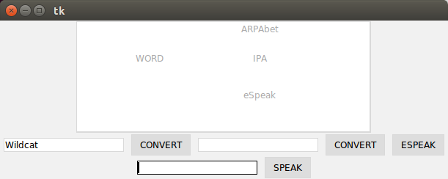
Interface
UI interface and API to allow for easier usage

Slide 33
Interface Properties
Allows for word to phoneme and phoneme to word conversion.
Word can be converted to IPA, ARPAbet or eSpeak notation.
The user can also simply enter a sentence which he or she wants to speak and it will speak it.

Slide 34
Performance:
We performed 5 fold cross validation after permuting the input set. The results are as follows:
Average Word Conversion Accuracy : 0.7338947118582697
Average Phoneme Conversion Accuracy : 0.8014263311120567

Slide 35
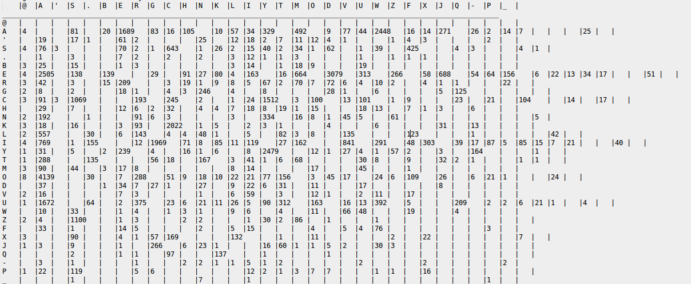
Confusion Matrix (GrGr)

Slide 36
Confusion Matrix (GrGr) conclusions
We can see that some alphabets are characteristic of being confused to others
A↔E,A↔O,S↔C, E↔I etc.
These confusion are legitimate as even english has these issues.

Slide 37
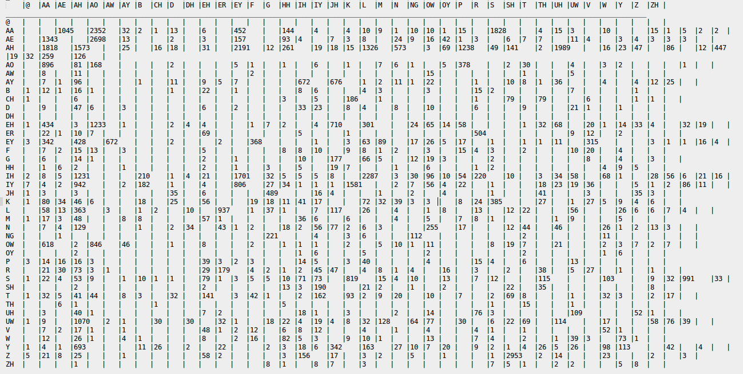
Confusion Matrix(PhPh)

Slide 38
Confusion Matrix (PhPh) conclusions
We can see that some phonemes are characteristic of being confused to others
AA↔AE,AA↔AH,OW↔AA, AH↔AE etc.
These confusion are legitimate as the sounds are close and their occurrences are in generally similar surrounding context.

Slide 39
Optimisation Attempts
Non Zero probability initially
Trigram Model
Neural Networks(Later)

Slide 40
Non Zero initial probability
The logic behind this is that many possibilities of the state diagram is nullified by the 0 probabilities existing due to no data seen for these transitions.
Instead of 0 we add 10-10 to allow for some weightage. We see not too much improvement of 0.01%(not much huh!)
Average Word Conversion Accuracy : 0.7430759192440042
Average Phoneme Conversion Accuracy : 0.8014293446848637

Slide 41
Trigram:
We changed the state machine to work with trigrams. The results were as follows:
Average Word Conversion Accuracy : 0.6153025931351043
Average Phoneme Conversion Accuracy : 0.7398425392381858

Slide 42
Trigram Output Analysing
The performance of the machine reduces with the trigram assumption(besides it takes significantly more time to solve), this is expected for the reason that the new state transistion ((S1,S2),S3,O) requires more training to get trainined and that the english model for equi-phone-grapheme words may not be too much effected by this assumption.

Slide 43
Neural Networks

Slide 44
Neural Networks
Bijoy Singh (120050087)
Sai Kiran Mudulkar(120050068)
Manik Dhar(120050006)

Slide 45
Perceptron Model
We implemented the perceptron model in the general form.
𝛉 was a part of the weights with constant input of -1
Both the models for deciding the value of the output were allowed(step threshold and sigmoidal threshold)
Also we made the schema general enough to use directly as well in a Neural Network

Slide 46
Perceptron Training
Perceptron training for problems just one perceptron uses the PTA algorithm.
It takes a truth table modifies it to create appropriate classes and inverts 0 class.
It now trains using the PTA algorithm which is guaranteed to converge if the function is separable.

Slide 47
Perceptron Performance
A perceptron can solve the problems as one would expect:
AND
OR
MAJORITY
but cannot to
PALINDROME (if it could it would be able to solve XOR, which we know it cannot)
XOR

Slide 48
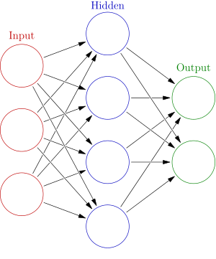
Neural Networks
We now used our existing infrastructure of perceptrons and using the sigmoid threshold neuron model, we used the to make a neural network

Slide 49
Neural Network
The user can specify
The number of inputs, number of neurons on each row, the number of outputs, η(for Δw_{ij} ) and the accuracy anticipated.
This way the user can control the learning rate(through η) and the final result accuracy.

Slide 50
Neural Network Training
We use the standard back propagation algorithm with the parameters η and accuracy(ɛ).
For the smaller boolean circuits, we have trained the network until the ɛ becomes very small(0.1) this can be modified by the user
The algorithm stops when the training is complete

Slide 51
Neural Network Performance
The neural network was tested on the following circuits and it performed as expected
3 input PALINDROME
4 input PALINDROME
XOR
FULL ADDER

Slide 52
Visual Results of Neural Training
Now the results of these neural networks are a bit difficult to visualise from text. Hence we made a module to allow for UI output for the neurons
The outputs of the various neural networks are displayed

Slide 53
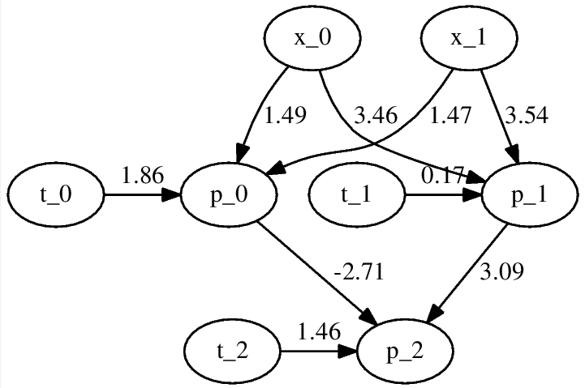
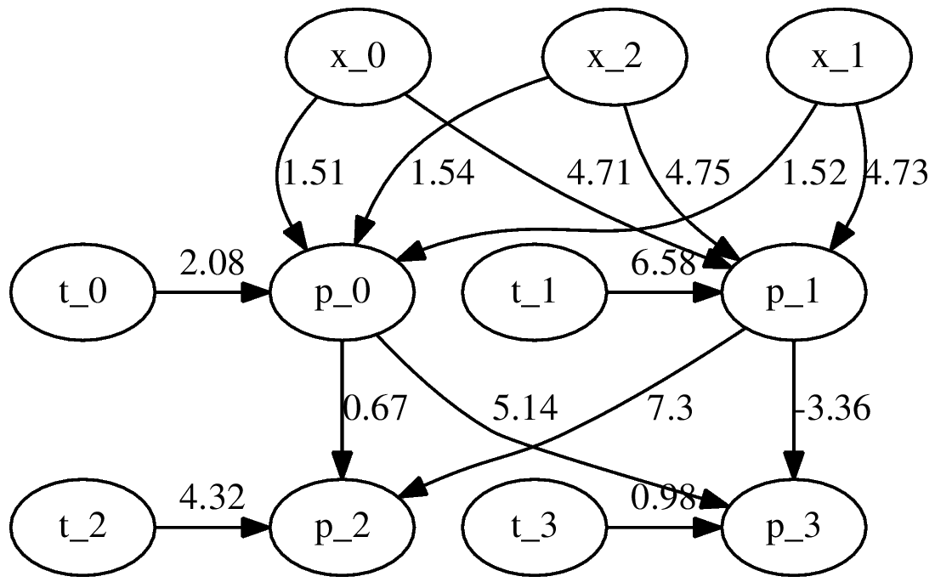
Visual Results of Neural Training
FULL ADDER
XOR

Slide 54
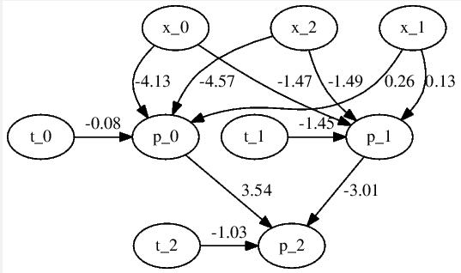
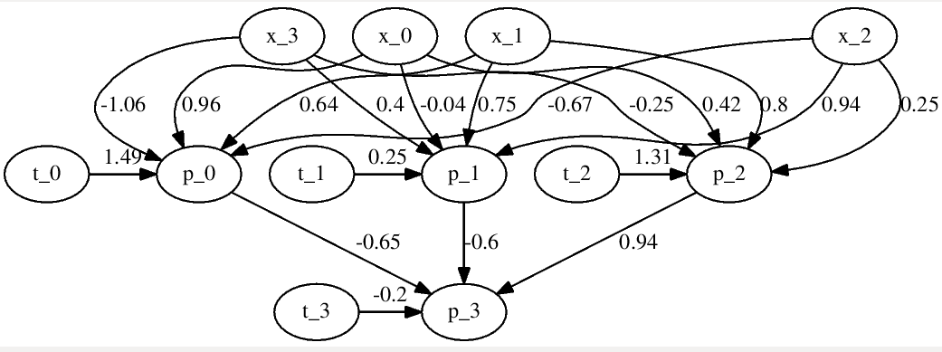
Visual Results of Neural Training
3 PALINDROME
4 PALINDROME

Slide 55
Grapheme To Phoneme using NN
We encoded the graphemes and phonemes using bit sequences by giving each grapheme and a phoneme a bit representation as given in the question
For padding we used 0000...
For testing we used this bit sequence

Slide 56
Training Adjustment
As the neural network is large we cannot expect it to train over the entire data till convergence(which is not even known if it will happen),
We iterate over a large cycles to let it train the data. The user can specify this using a command line argument

Slide 57
Neural Network Performance
The neural network performance is mixed* (we’ll analyse this later in this presentation and see why this answer isn’t the best measure what our system could achieve)
Measures to look at:
Word Length
Test Cases
Training Duration
Character Accuracy
Bit Accuracy

Slide 58
THE RESULTS
 | Test Case 1 | Test Case 2 | Test Case 3 | Test Case 4 | Tes
Test Case | Word Length 4 Test cases 10 | Word Length 4 Test cases 10 | Word Length 6 Test cases 100 | Word Length 8 Test cases 1000 | Word Length 10 Test cases 10000
Training Duration | 10000 iterations 1m 45.074s | 100000 iterations 9m40.104s | 20000 iterations ~10 hours | 20000 iterations 5 days 22hours!!!!! (Yes we actually ran that on a server for 6 days just to see what happens) | 1000 iterations 115m7.984s
Accuracy | 70.0% | 82.5% | 32.66% | 54.72% | 23.9986%
Word Efficiency | 97.1428% | 98.5714% | 83.11% | 89.6719% | 73.463%

Slide 59
Performance Issues and Improvements
The performance on smaller data being so high indicate that the mechanism has the potential of performing well,
However but as the amount of data becomes bigger, the amount of time to train(to the same level) increases exponentially.
Hence the increased requirement in time but reduced accuracy

Slide 60
How we can improve the accuracy
Increase the time to train (exponential)
Use more sparse numbering of the input grapheme bits
Dont use padding and work with only a standard size

Slide 61
THANK YOU

